Slide 1
Javascript DOM
By Anastasiia Khudnytska

Slide 2
DOM tree
The backbone of an HTML document is tags.
According to the Document Object Model (DOM), every HTML tag is an object. Nested tags are “children” of the enclosing one. The text inside a tag is an object as well.
All these objects are accessible using JavaScript, and we can use them to modify the page.

Slide 3
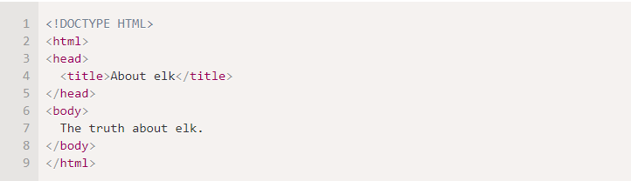
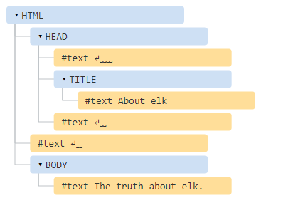
An example of the DOM
The DOM represents HTML as a tree structure of tags. Here’s how it looks:
Tags are element nodes (or just elements) and form the tree structure: <html> is at the root, then <head> and <body> are its children, etc.
Note the special characters in text nodes:
a newline: ↵ (in JavaScript known as \n)
a space: ␣

Slide 4
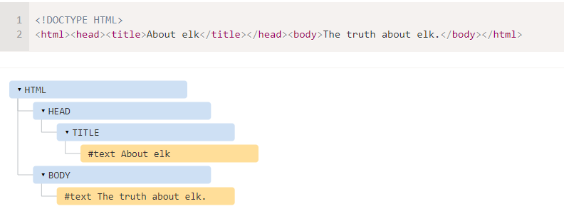
Here are no space-only text nodes:

Slide 5
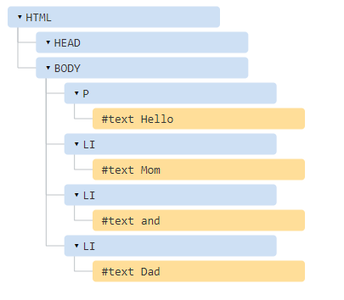
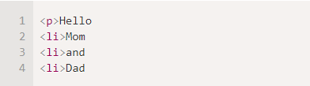
Autocorrection
If the browser encounters malformed HTML, it automatically corrects it when making the DOM.
For instance, the top tag is always <html>. Even if it doesn’t exist in the document, it will exist in the DOM, because the browser will create it. The same goes for <body>.
A document with unclosed tags:
…will become a normal DOM as the browser reads tags and restores the missing parts:

Slide 6
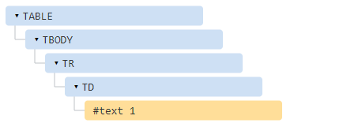
Tables always have <tbody>
An interesting “special case” is tables. By the DOM specification they must have <tbody>, but HTML text may (officially) omit it. Then the browser creates <tbody> in the DOM automatically.
For the HTML:
DOM-structure will be:

Slide 7
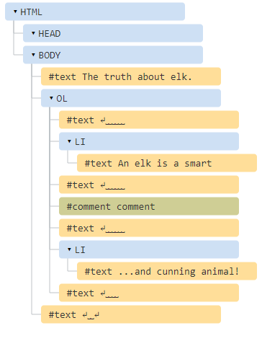
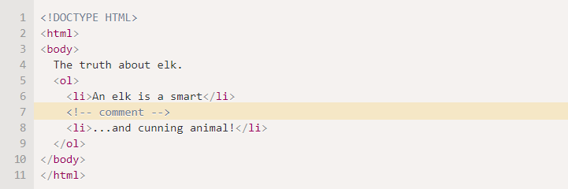
Comment
We may think – why is a comment added to the DOM? It doesn’t affect the visual representation in any way. But there’s a rule – if something’s in HTML, then it also must be in the DOM tree.

Slide 8
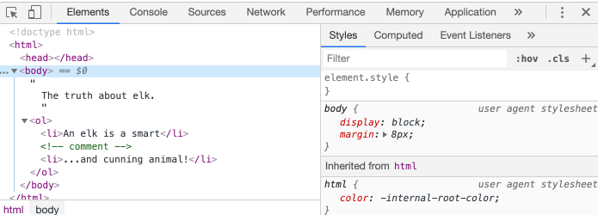
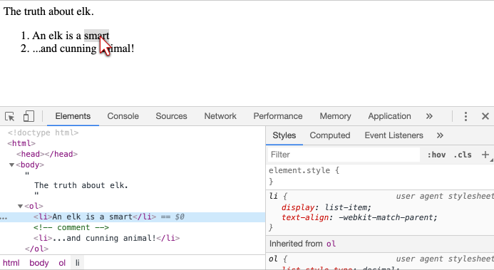
DOM structure in real-time
Clicking the button in the left-upper corner allows us to choose a node from the webpage using a mouse (or other pointer devices) and “inspect” it (scroll to it in the Elements tab). This works great when we have a huge HTML page (and corresponding huge DOM) and would like to see the place of a particular element in it.
Another way to do it would be just right-clicking on a webpage and selecting “Inspect” in the context menu.

Slide 9
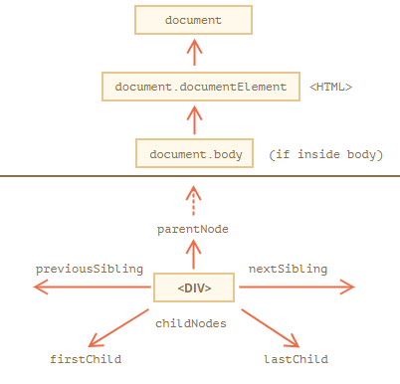
Walking the DOM
The DOM allows us to do anything with elements and their contents, but first we need to reach the corresponding DOM object.
All operations on the DOM start with the document object. That’s the main “entry point” to DOM. From it we can access any node.
Here’s a picture of links that allow for travel between DOM nodes:

Slide 10
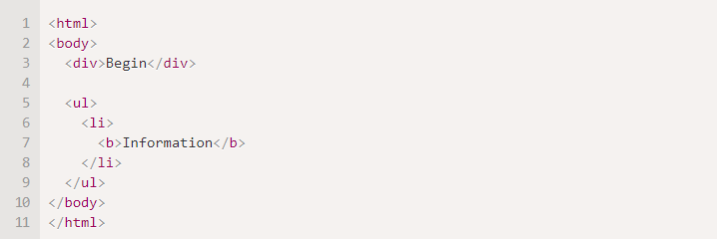
Children: childNodes, firstChild, lastChild
Child nodes (or children) – elements that are direct children. In other words, they are nested exactly in the given one. For instance, <head> and <body> are children of <html> element.
Descendants – all elements that are nested in the given one, including children, their children and so on.
For instance, here <body> has children <div> and <ul> (and few blank text nodes):

Slide 11
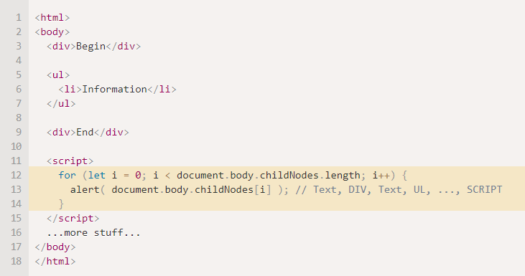
The childNodes collection lists all child nodes, including text nodes.
The example below shows children of document.body:

Slide 12

Properties firstChild and lastChild give fast access to the first and last children.
They are just shorthands. If there exist child nodes, then the following is always true:
There’s also a special function elem.hasChildNodes() to check whether there are any child nodes.

Slide 13
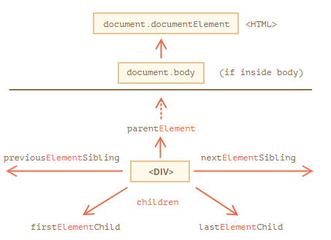
Element-only navigation
The links are similar to those given above, just with Element word inside:
children – only those children that are element nodes.
firstElementChild, lastElementChild – first and last element children.
previousElementSibling, nextElementSibling – neighbor elements.
parentElement – parent element.

Slide 14
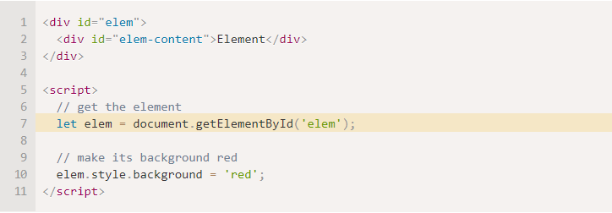
Searching: getElement*, querySelector*
If an element has the id attribute, we can get the element using the method document.getElementById(id), no matter where it is.
For instance:

Slide 15
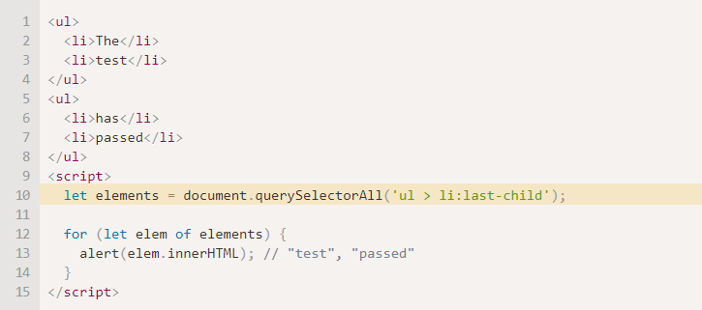
By far, the most versatile method, elem.querySelectorAll(css) returns all elements inside elem matching the given CSS selector.
Here we look for all <li> elements that are last children:
Pseudo-classes in the CSS selector like :hover and :active are also supported. For instance, document.querySelectorAll(':hover') will return the collection with elements that the pointer is over now (in nesting order: from the outermost <html> to the most nested one).

Slide 16
querySelector
The call to elem.querySelector(css) returns the first element for the given CSS selector.
In other words, the result is the same as elem.querySelectorAll(css)[0], but the latter is looking for all elements and picking one, while elem.querySelector just looks for one. So it’s faster and also shorter to write.
getElementsBy*
There are also other methods to look for nodes by a tag, class, etc.
Today, they are mostly history, as querySelector is more powerful and shorter to write.
So here we cover them mainly for completeness, while you can still find them in the old scripts.
elem.getElementsByTagName(tag) looks for elements with the given tag and returns the collection of them. The tag parameter can also be a star "*" for “any tags”.
elem.getElementsByClassName(className) returns elements that have the given CSS class.
document.getElementsByName(name) returns elements with the given name attribute, document-wide. Very rarely used.

Slide 17

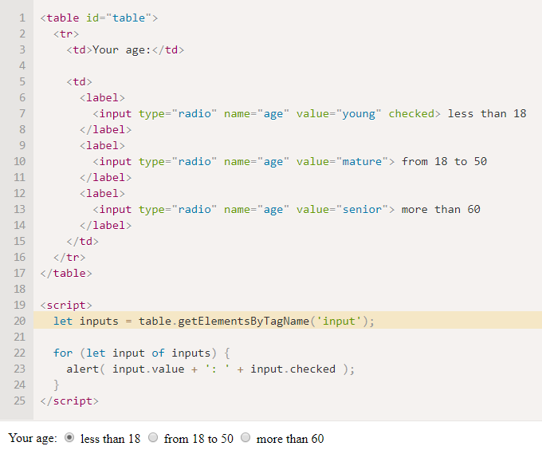
Find all input tags inside the table:

Slide 18
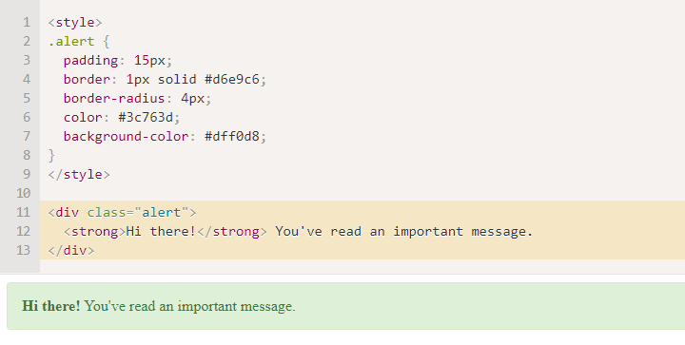
Modifying the document
We’ll add a message on the page that looks nicer than alert.
Here’s how it will look:

Slide 19

Modifying the document
To create DOM nodes, there are two methods:
document.createElement(tag)
Creates a new element node with the given tag:
document.createTextNode(text)
Creates a new text node with the given text:
We created the element, but as of now it’s only in a variable. We can’t see the element on the page, as it’s not yet a part of the document.

Slide 20
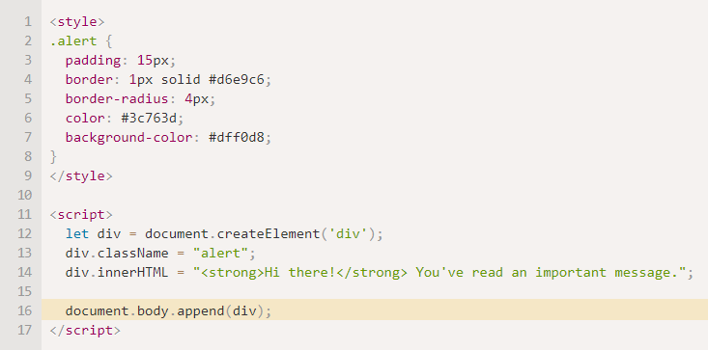
Modifying the document
To make the div show up, we need to insert it somewhere into document. For instance, in document.body.
There’s a special method append for that: document.body.append(div).

Slide 21
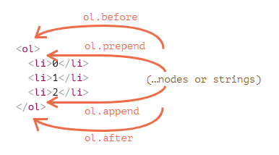
Modifying the document
node.append(...nodes or strings) – append nodes or strings at the end of node,
node.prepend(...nodes or strings) – insert nodes or strings at the beginning of node,
node.before(...nodes or strings) –- insert nodes or strings before node,
node.after(...nodes or strings) –- insert nodes or strings after node,
node.replaceWith(...nodes or strings) –- replaces node with the given nodes or strings.

Slide 22


